Slide 1


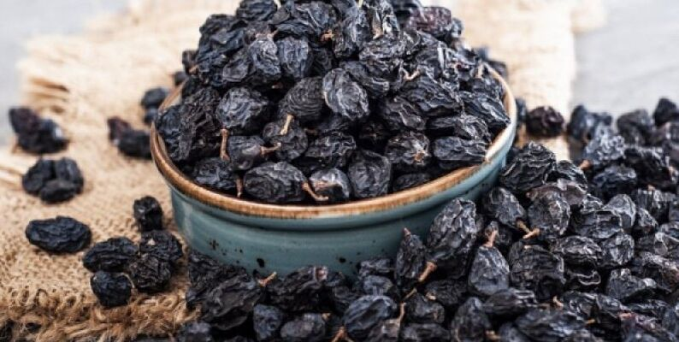
Introduction
Binomial Classification (Unsupervised Machine Learning)
Introduction to Data Science with Python
Summative Assessment 2 - Presentation
Binomial Classification for Raisin Grains
Course Convener: Dr. Joshua F. Einsle
Student: Allan Hernandez Cotto, 2589702H
Problem Statement
Predict the correct raisin class (Kecimen or Besni) given a set number of features.
Data description
CSV format
900 samples
7 features / 1 target
CINAR I., KOKLU M. and TASDEMIR S., (2020). Classification of Raisin Grains Using Machine Vision and Artificial Intelligence Methods, Gazi Journal of Engineering Sciences, vol. 6, no. 3, pp. 200-209, December 2020, DOI: https://doi.org/10.30855/gmbd.2020.03.03

Slide 2
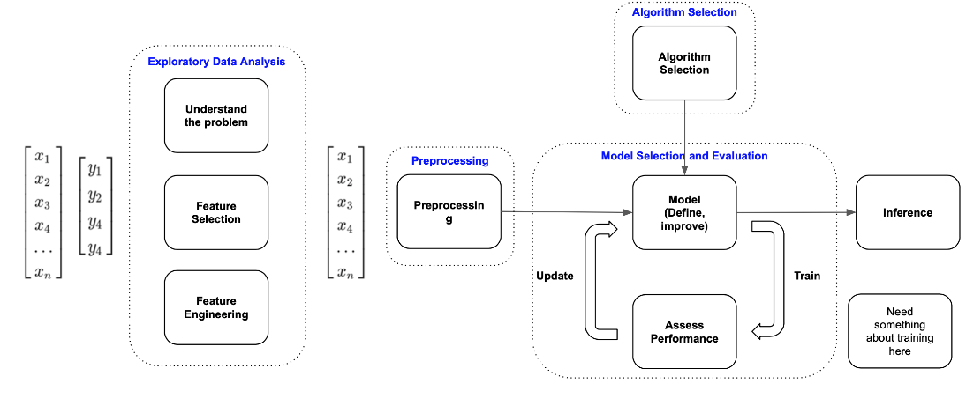
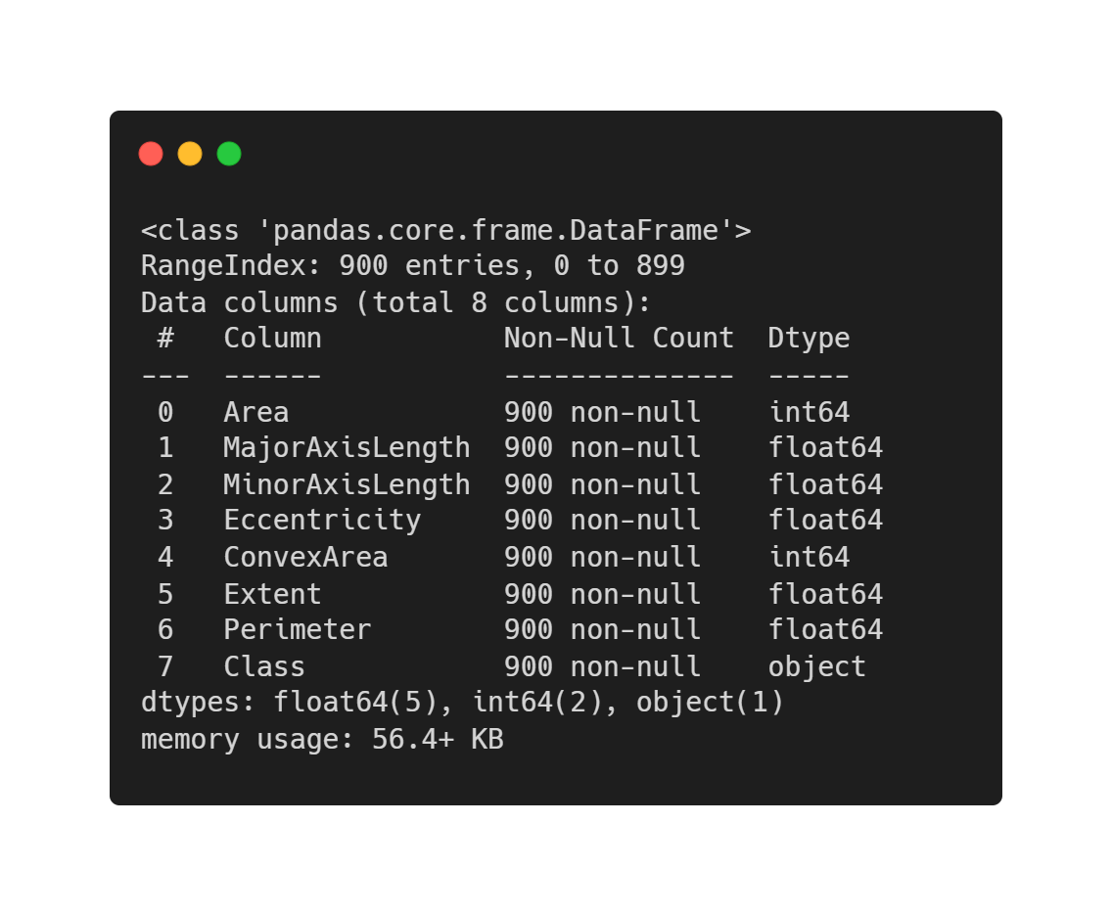
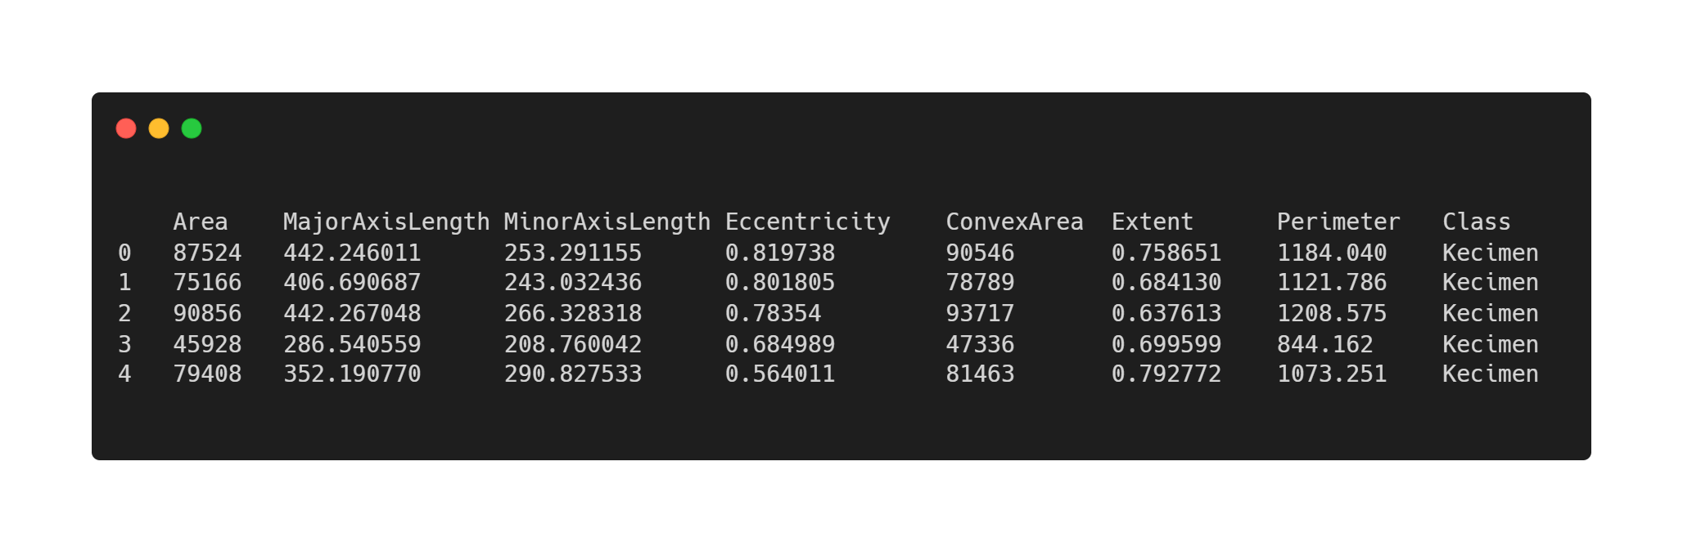
Methodology:
Machine Learning Workflow
Exploratory data analysis

Slide 3
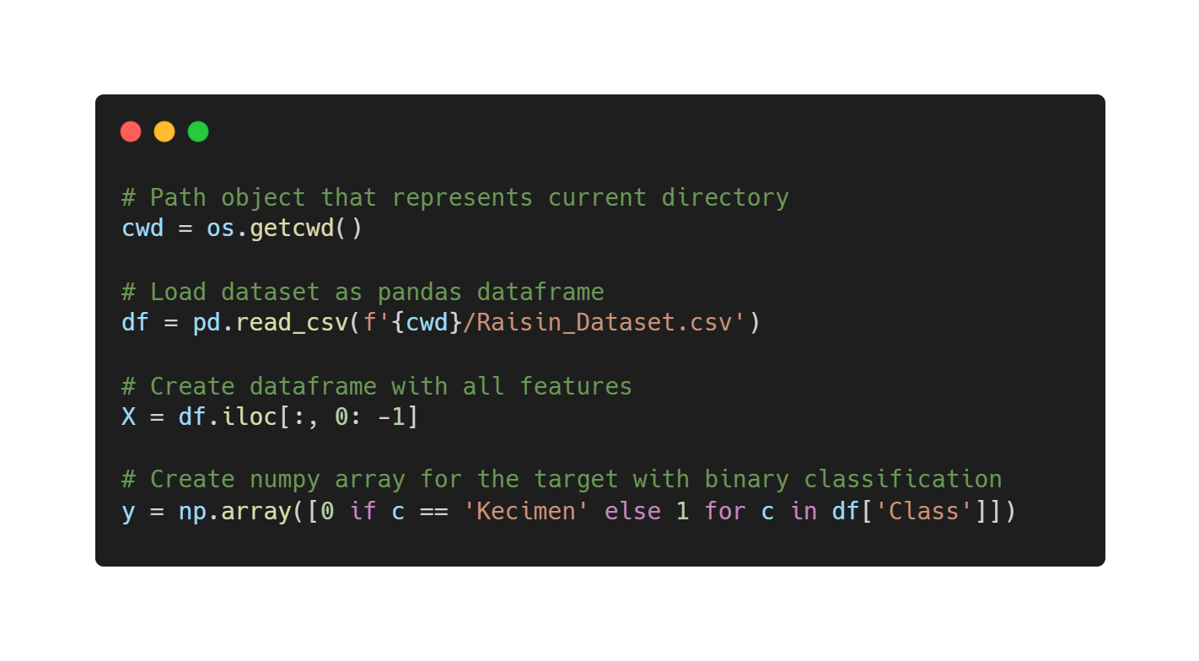
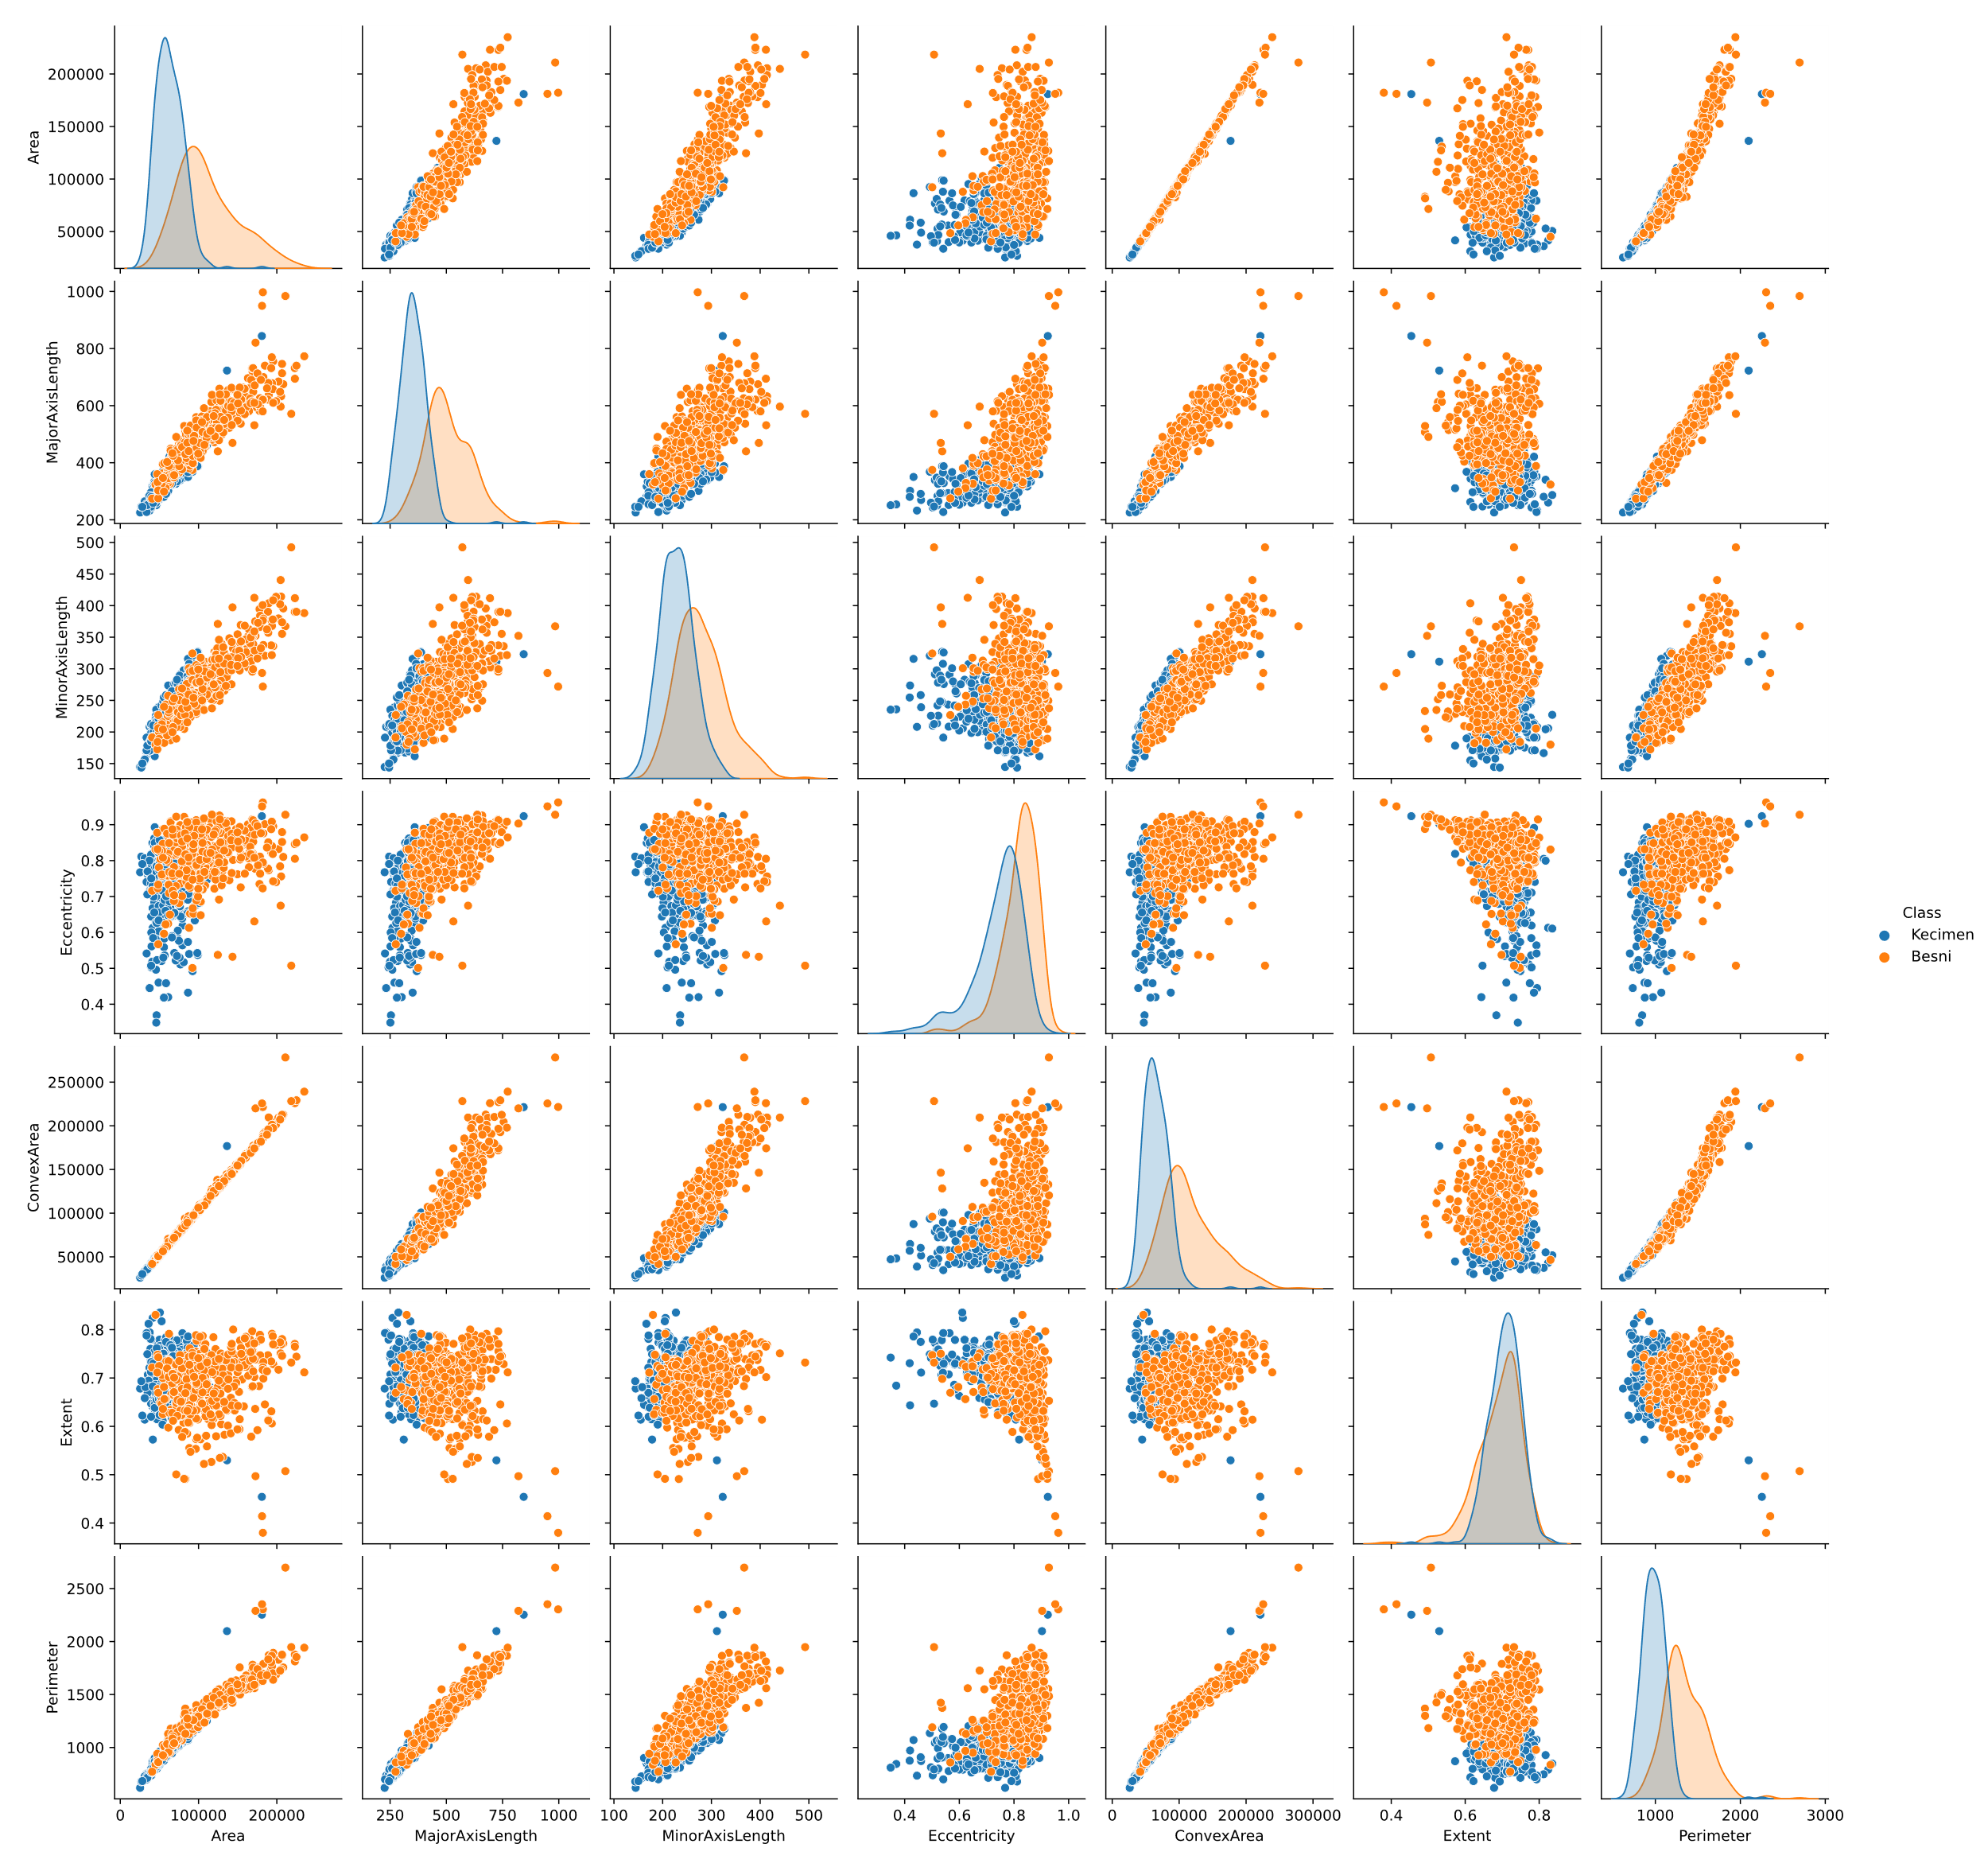
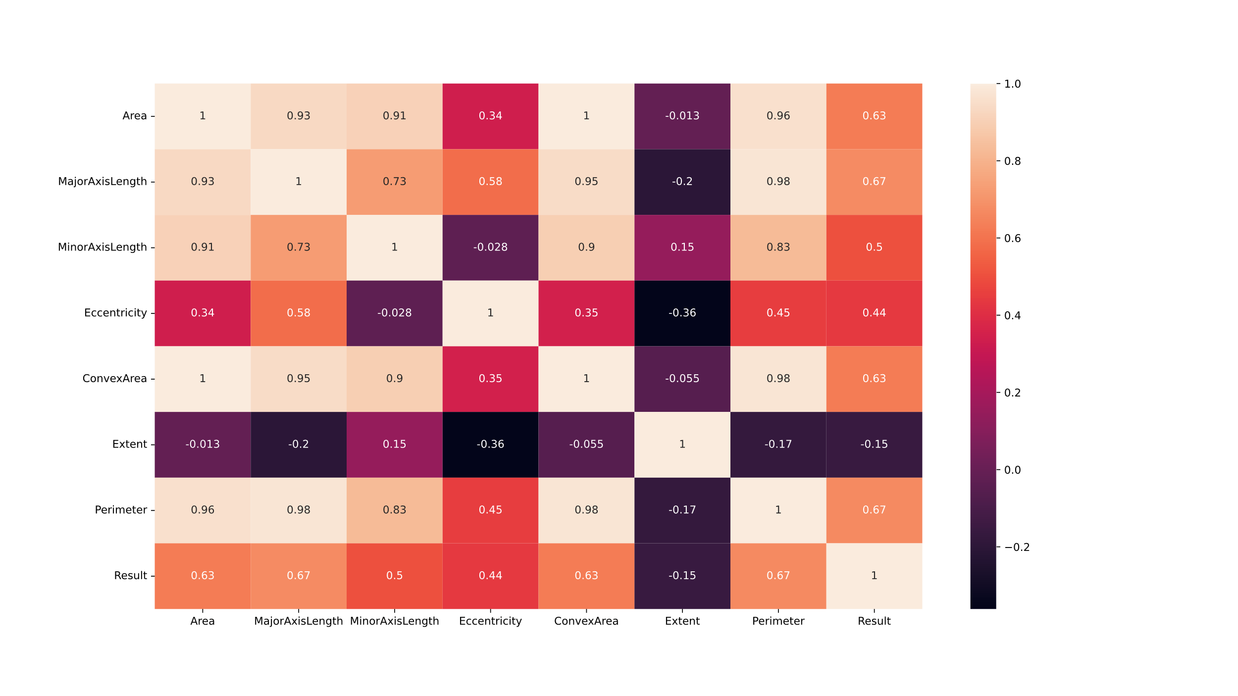
Data analysis and preprocessing
Pair plot
Heat map
Target
Column

Slide 4
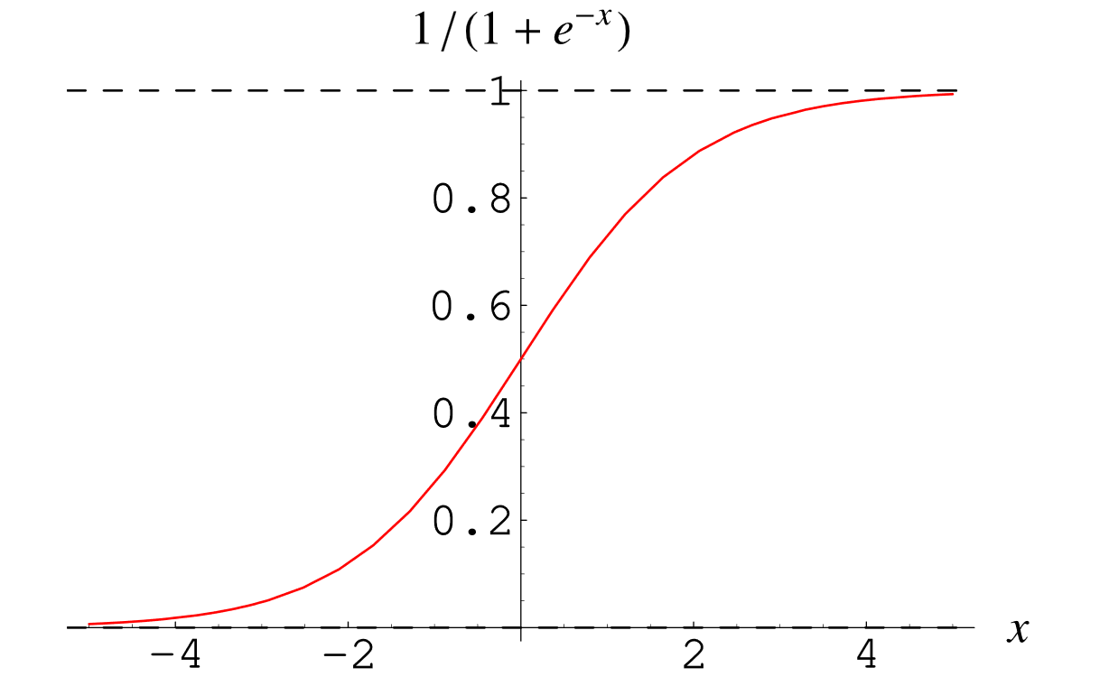
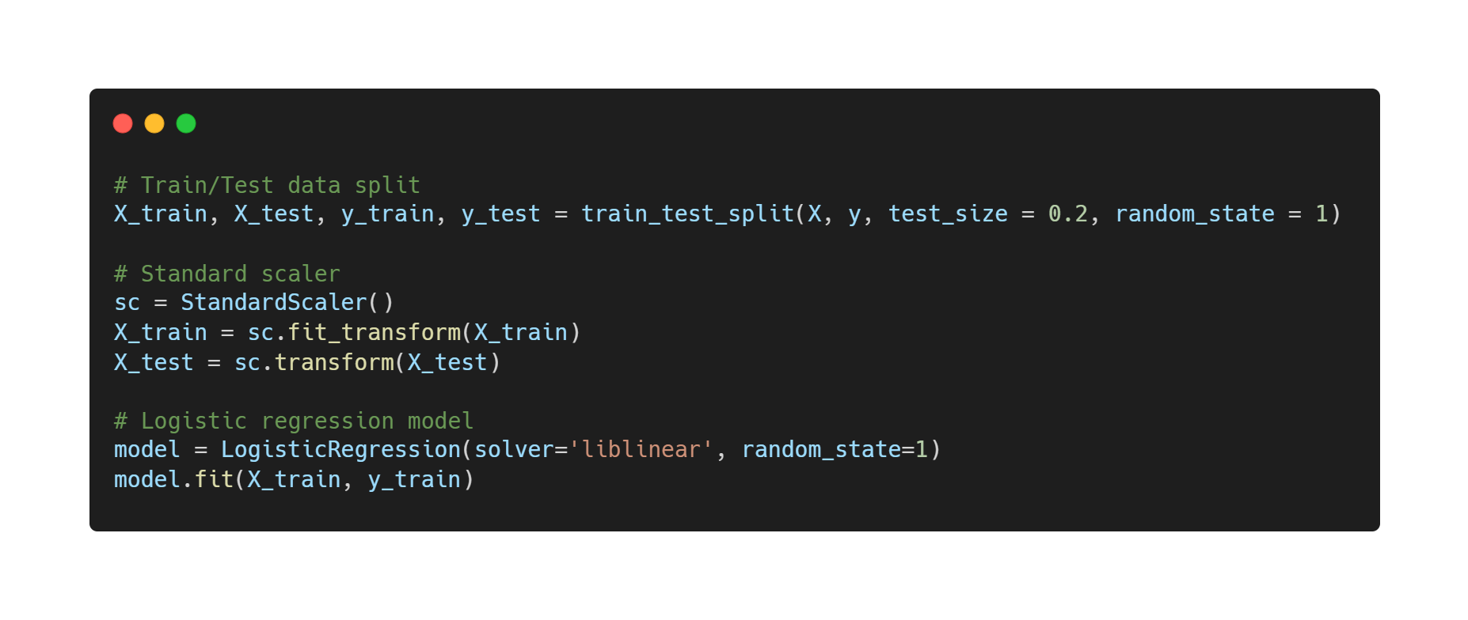
Model Selection:
Logistic Regression
Benefits:
Fast
Clear interpretations
Suitable for binary classification
Alternatives:
SVM
Random forest
Decision tree
Sigmoid Function

Slide 5
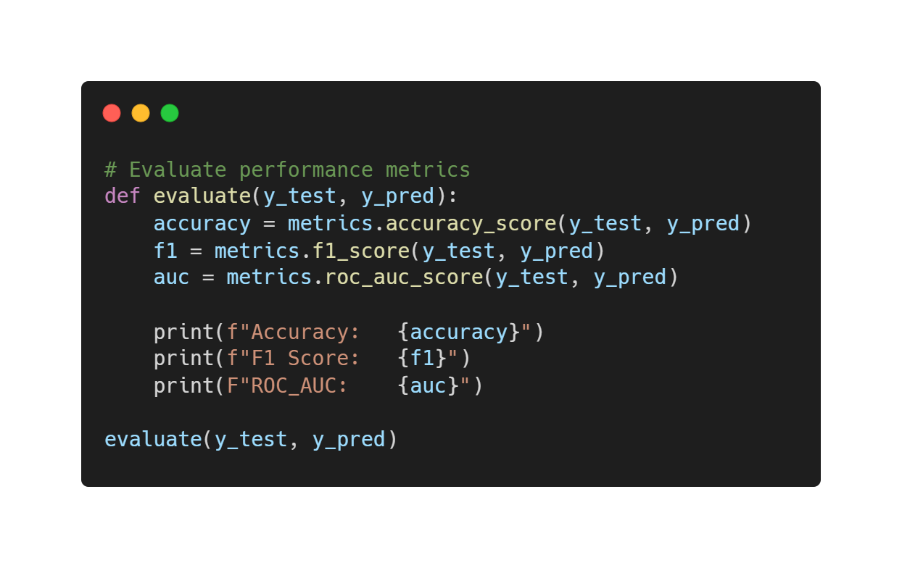
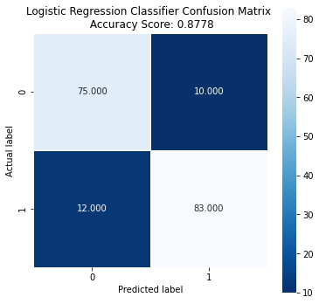


Results and Conclusion
Accuracy: 0.8777777777777778
F1 Score: 0.8829787234042553
ROC_AUC: 0.8780185758513932
Action Plans:
Compare different models
Hyperparameter optimization

